Slide 1


Slide 2
WRITING TASK 1_LINE GRAPH SUMMARY
Intro: paraphrase the question. (phần cần paraphrase)
(GRA) (n) => (v)
(countable nouns) the number of N (s/es) which + V
e.g: car ownership in Britain from 1971 to 2001.
=> The number of cars owned in Britain ...
(unC nouns) the amount of N which + V
e.g: total energy production in Britain from 1995 to 2005.
The amount of energy produced in ....
(SPECIFY) how many types, measurements, time
(VOCAB) find more task-specific synonyms
Notes:
B is to the Southeastern area of A

Slide 3
WRITING TASK 1_LINE GRAPH SUMMARY
Overview (dynamic charts): report the main features - no data
+, trend:
4 vital structures: v + adv = adj + n (a significant/significantly rise?)
Non-gradable verbs: jump, soar, surge x plummet, plunge, slump
Mutiplication: increase by 2/3/4/5 times (double, triple, quadruple, quintuple); decrease by a half/a quarter/two-thirds (halve).
***[the data for type] increase, NOT [type] increase
+, order:
[the data for type] was the highest/lowest
e.g: the consumption of fish was the lowest.
[type] registered [the highest data]
e.g: fish registered the lowest consumption.
Notes:
B is to the Southeastern area of A

Slide 4
WRITING TASK 1_LINE GRAPH SUMMARY
Bodies: report in details
+, Body 1: nhóm theo trend giống nhau
S1: (start from the highest): In [1st year], the data for ... was/stood at (data)
S2: (compare - other categories in body 1): This figure was ... higher than that/those for ...
S3: trend – highest
S4: trend – other category
+, Body 2:
S1: Quite a similar – different – an opposite pattern can be seen in ...’s data.
S2: trend – loại còn lại
Notes:
B is to the Southeastern area of A

Slide 5
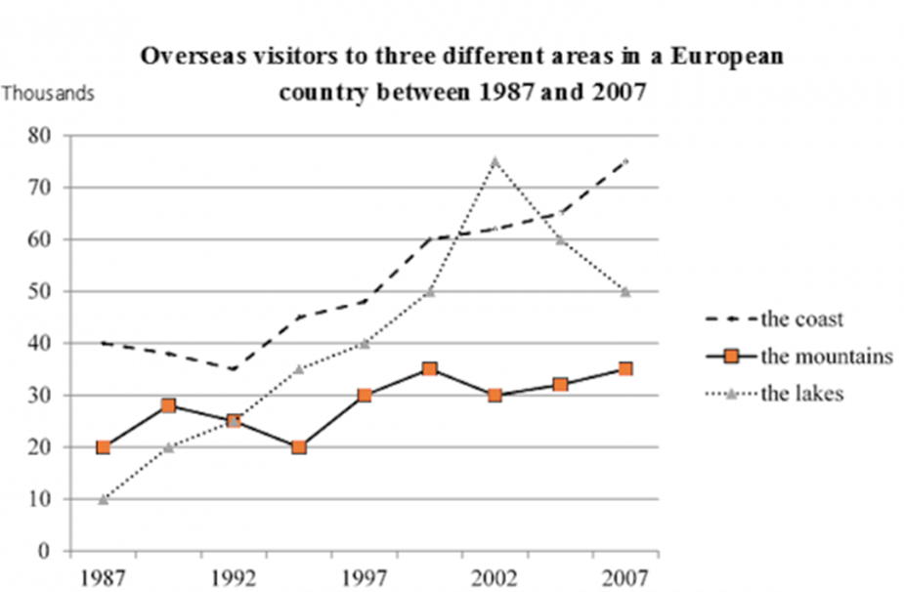
Question: The graph below shows the number of overseas visitors to three different areas in a European country between 1987 and 2007
The given line graph compares the number of foreign tourists to types of natural landscapes in a particular European nation over a 20-year period starting from 1987
Notes:
B is to the Southeastern area of A

Slide 6
Overview:
[trend] subjects
The number of visitors/travellers/tourists to [type]
The number for [type]
Visits to [type] (số lượt đến)
Trips to [type]
As is evident from the chart, significantly more foreigners visited the three areas, with the data for the coast and the lakes climbing at a greater degree. In addition, the coast was always the most popular choice for visitors except for the year 2002.
Notes:
B is to the Southeastern area of A

Slide 7
Body 1_outline
S1: (start from the highest): In [1st year], the data for ... was/stood at (data)
S2: (compare - other categories in body 1): This figure was ... higher than that/those for ...
S3: trend – highest
S4: trend – other category
Notes:
B is to the Southeastern area of A

Slide 8
Body 1_full body
In 1987, the coast attracted 40 thousand tourists, quadrupling the lakes. Then, the number of visitors to coastal areas went down slightly in 1992 before it surged to over 70 thousand at the end of the period. Meanwhile, trips to the lakes leapt to 75 thousand in 2002 when it surpassed that to the coast, but then slumped by 25 thousand at the end of the period.
Notes:
B is to the Southeastern area of A

Slide 9
Body 2_full body
Quite a different pattern can be seen in the number of tourists going to the mountains. Starting off at 20 thousand, it fluctuated between 1987 and 2002, followed by a slight upward trend to reach a peak of approximately 35 thousand in 2007. It is also noticeable that in 1992, the numbers for the lakes and the mountains were identical/similar/equal, at about 25 thousand.
Notes:
B is to the Southeastern area of A

Slide 10
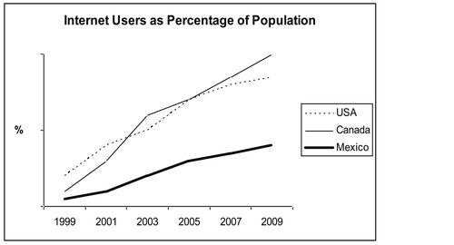
Question: The line graph compares the percentage of people in three countries who used the Internet between 1999 and 2009.
The given line graph compares the number of Internet users in three American nations, namely the USA, Canada and Mexico, over a period of 10 years starting from 1999
Notes:
B is to the Southeastern area of A

Slide 11
Overview:
[trend] subjects
The percentage of Internet users in [type]
The number for [type]
The rate of using the Internet in [type]
The number of netizens | the population (number of pp) who accessed the Internet in [type]
As is evident from the chart, there were significantly more netizens in three countries, with the numbers for USA and Canada increasing at a greater extent. It is also clear that the highest population using the Internet was in Canada and the USA
Notes:
B is to the Southeastern area of A

Slide 12
Body 1_outline
S1: (start from the highest): In [1st year], the data for ... was/stood at (data)
S2: (compare - other categories in body 1): This figure was ... higher than that/those for ...
S3: trend – highest
S4: trend – other category
Notes:
B is to the Southeastern area of A

